Slide 1
Welcome to Effective Management Strategies
MDGFOA Spring 2024 Conference

Slide 2
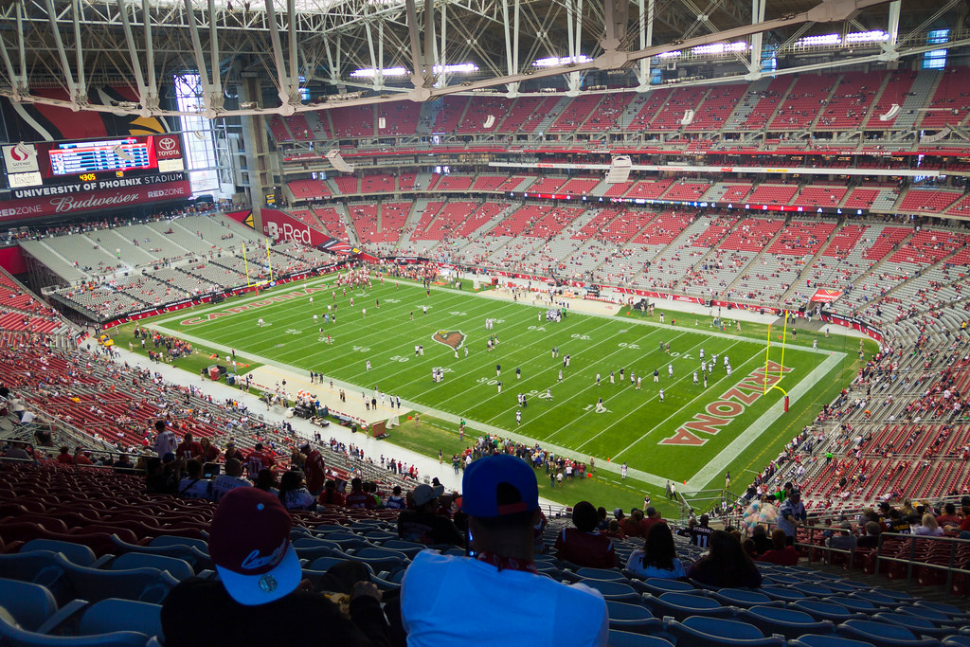
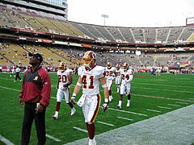

Slide 7
Learning Objectives
1
Identify proven leadership principles
2
Distinguish ways to strengthen management
3
Recall how to grow as a leader and manager

Slide 8
Leadership Principles
MDGFOA Spring 2024 Conference

Slide 9
Learning Objectives
1
Identify traits of great leadership
2
Recognize what holds us back as leaders
3
Identify how to strengthen your leadership

Slide 10
Leaders
Empower others
Thrive in adversity
See what others don’t see

Slide 11
Leaders are accountable

Slide 12
Leaders are accountable

Slide 13
3 Things That Define Leadership

Slide 15
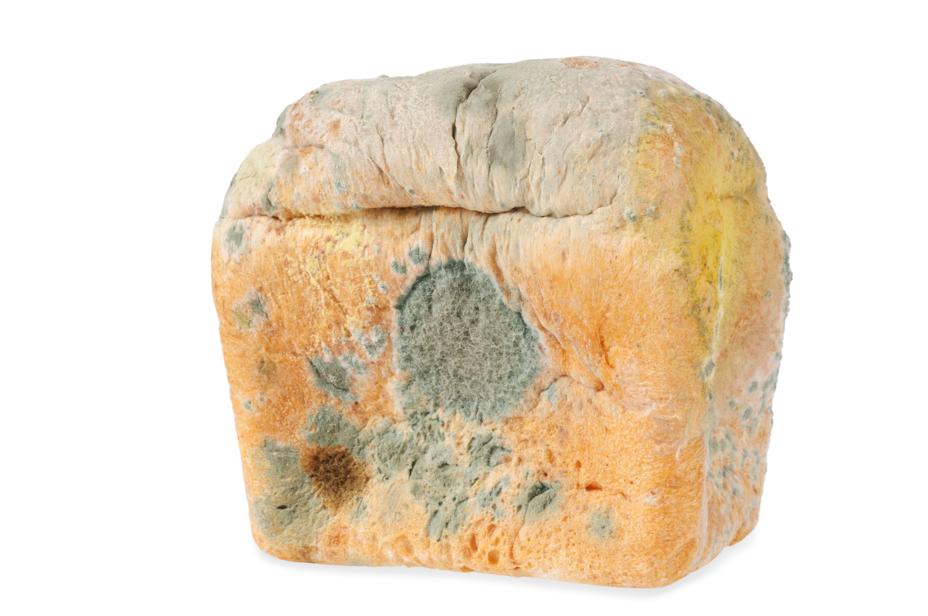
How leadership needs to change:

Slide 17
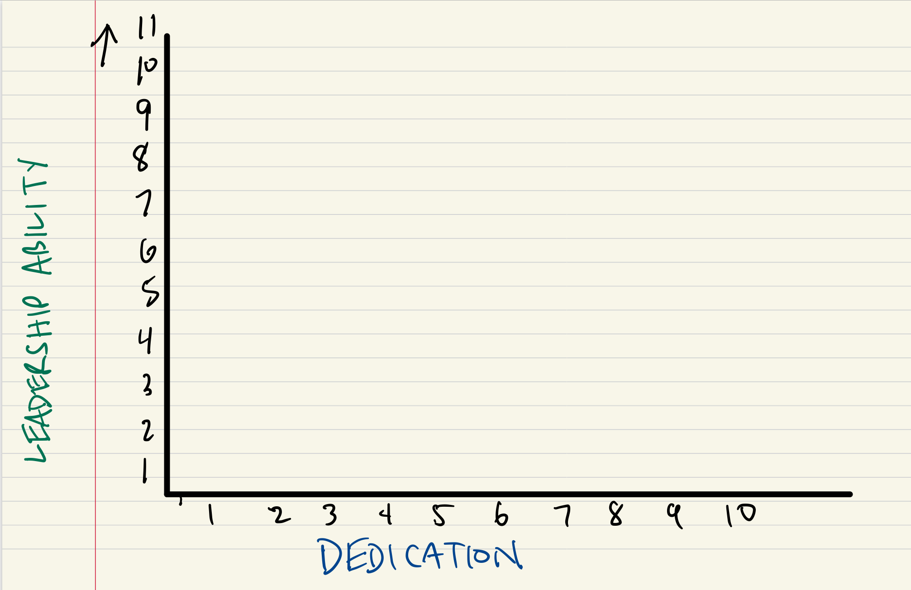

Slide 18
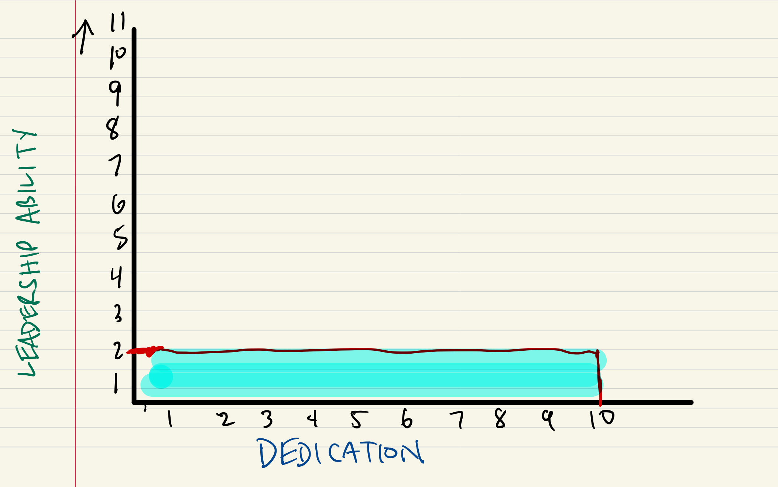
Effectiveness

Slide 19
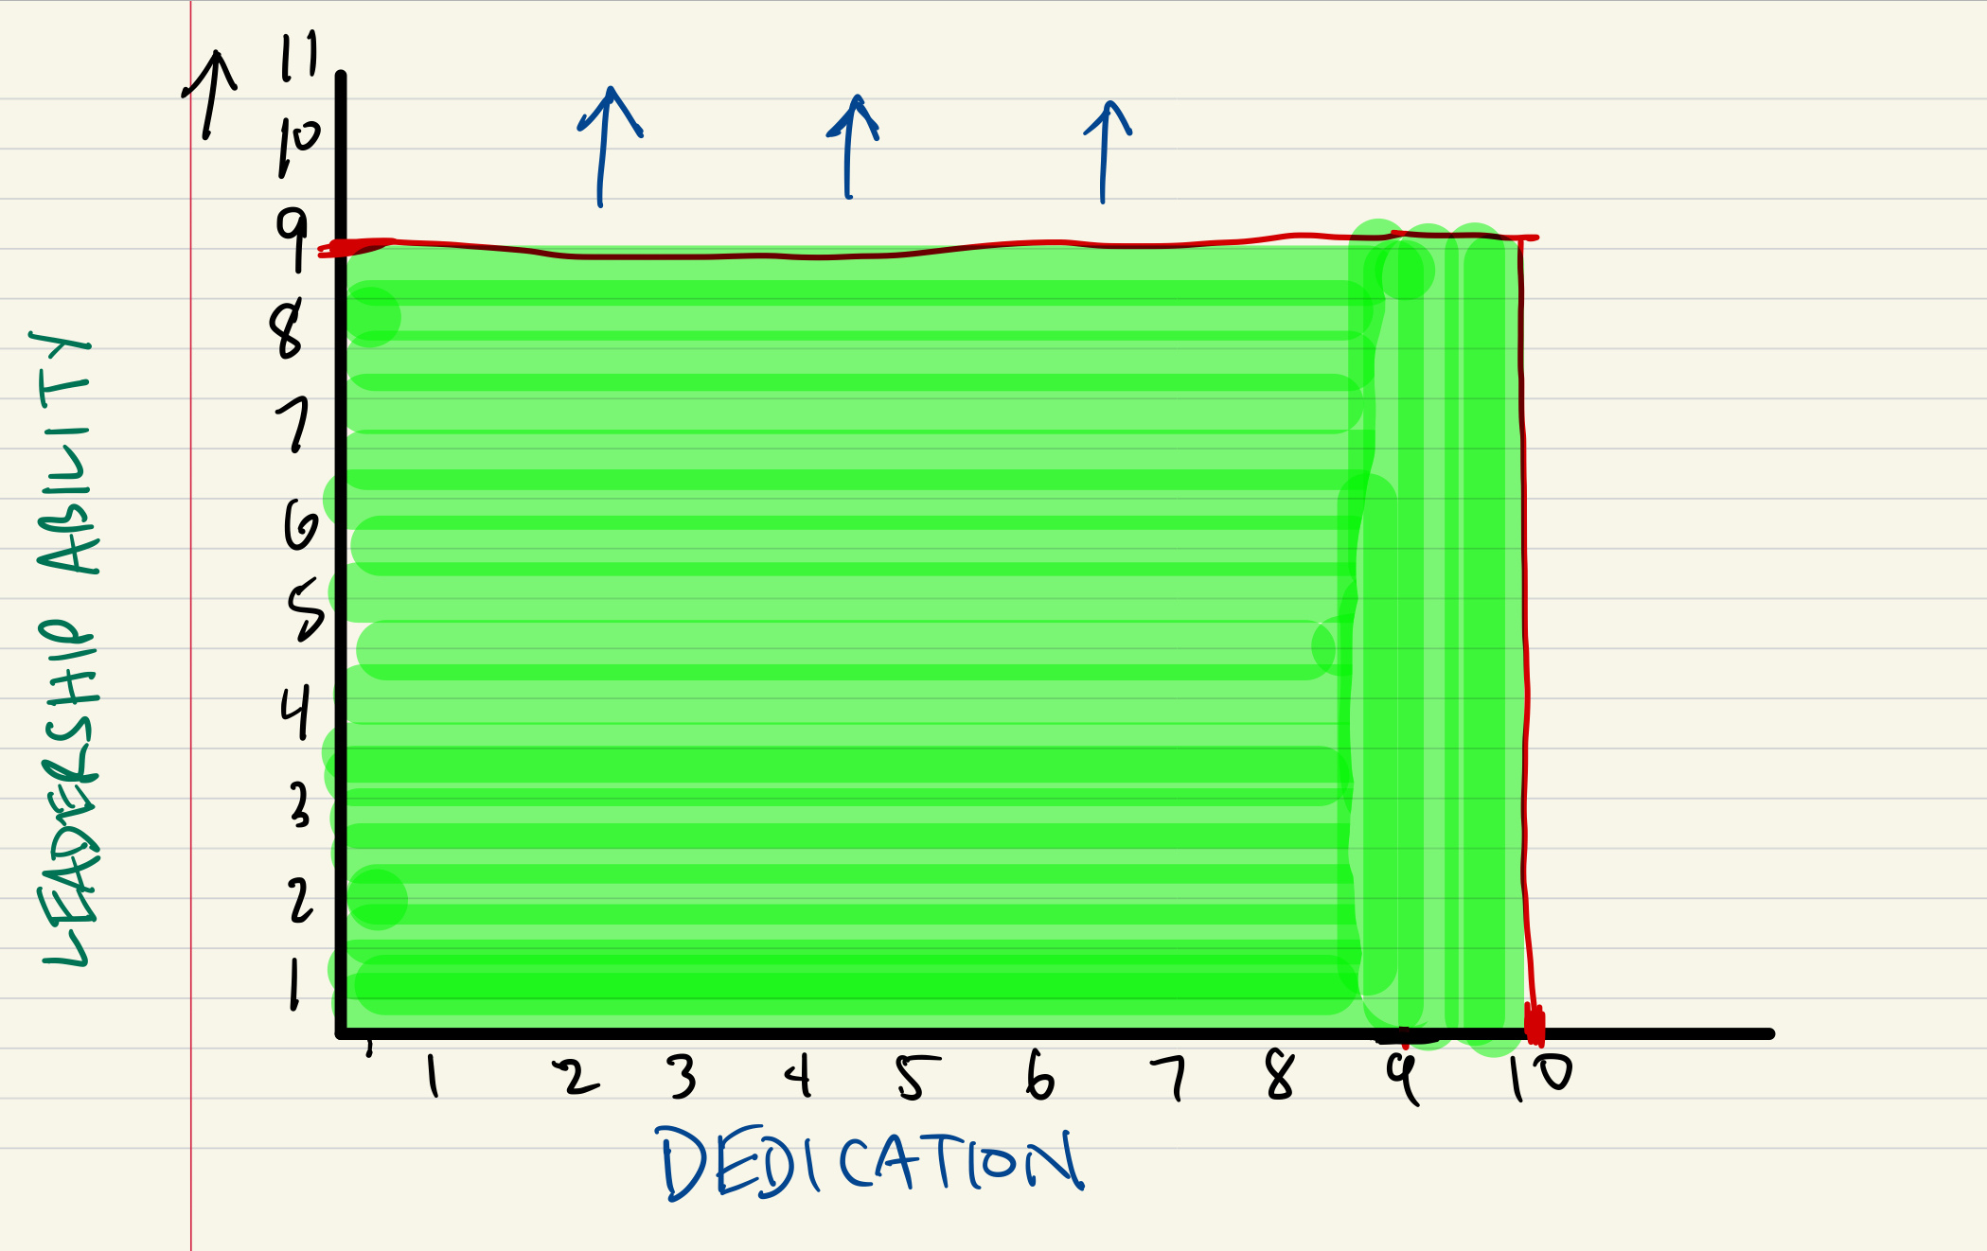
Effectiveness

Slide 20
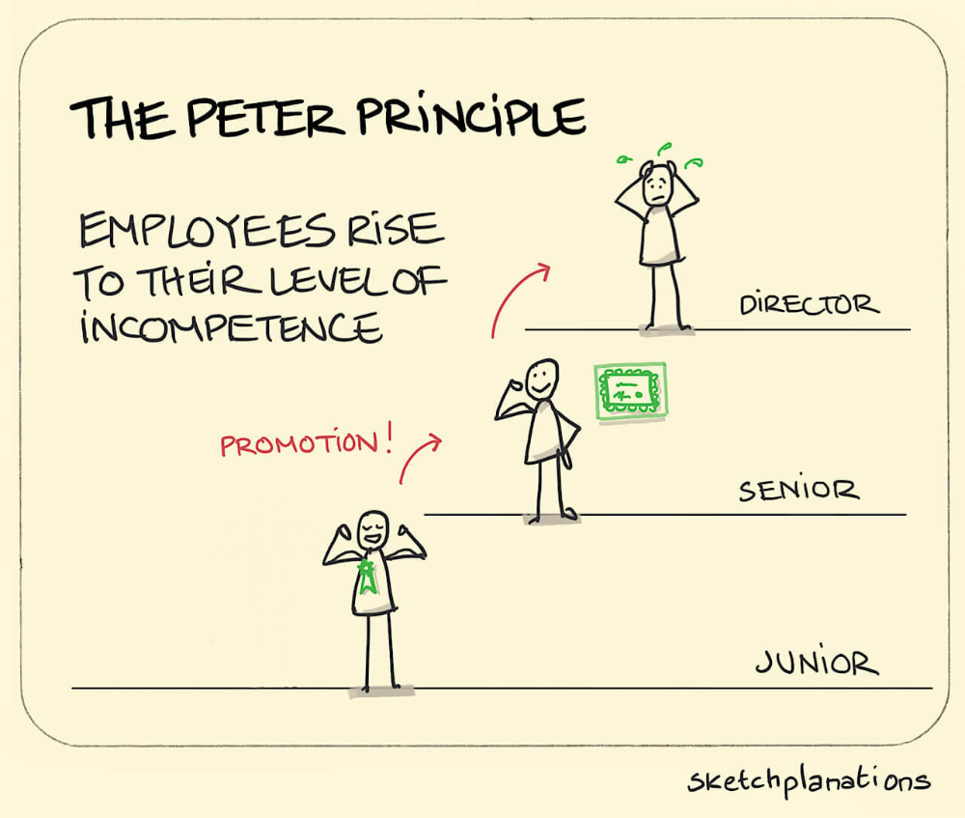

Slide 21
Think about the best boss you ever had. What were their traits?

Slide 22
4 Questions You Must Answer
Does this leader know where they’re going?
Do I want to go with them?
Can they help me get there?
Do I trust this leader?

Slide 23
Develop your Charisma
Traits of charismatic people:
Confidence
Conviction
Connection
Compassion

Slide 24
How to grow your Charisma
Love life – enjoy the journey
Be real, humble, yourself
Encourage people
See the best in others

Slide 26
Why we need influence
Performance and results
The ultimate measure of leadership
Trust and buy-in
Engagement and growth

Slide 27
Your influence is always working…
Your attitude and treatment of others
Your integrity and ethics
How you handle pressure

Slide 28
How can we build influence?
Make people feel important
Practice empathy
See their potential

Slide 29
How can we build influence?
Keep your word
Know what drives them
Know what annoys them

Slide 30
What or who is influencing you right now?

Slide 31
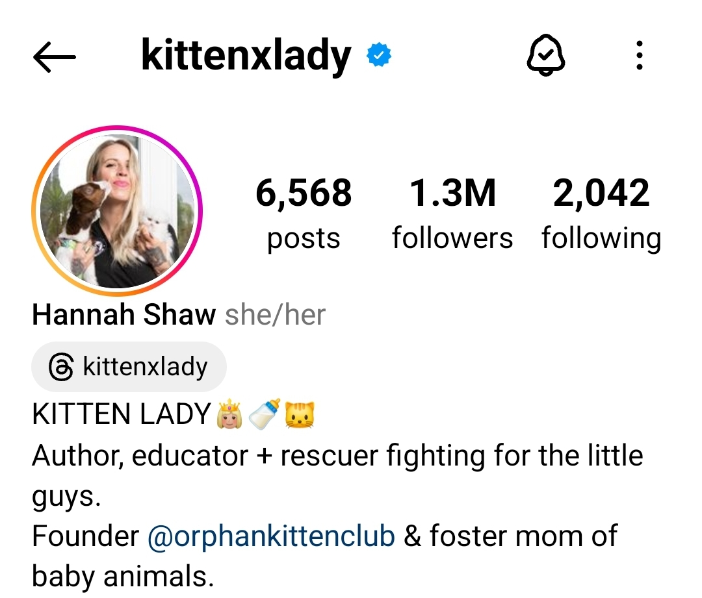

Slide 32
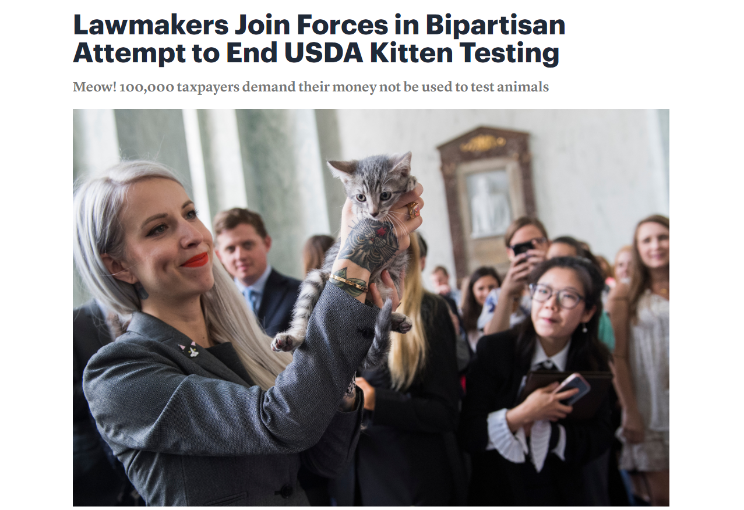

Slide 33
Management Strategies
MDGFOA Spring 2024 Conference

Slide 34
Learning Objectives
1
Identify how to build trust
2
Distinguish ways to deepen connection
3
Recognize feedback that drives performance

Slide 35
Happy people sell more.

Slide 36
Trust: given or earned?

Slide 37
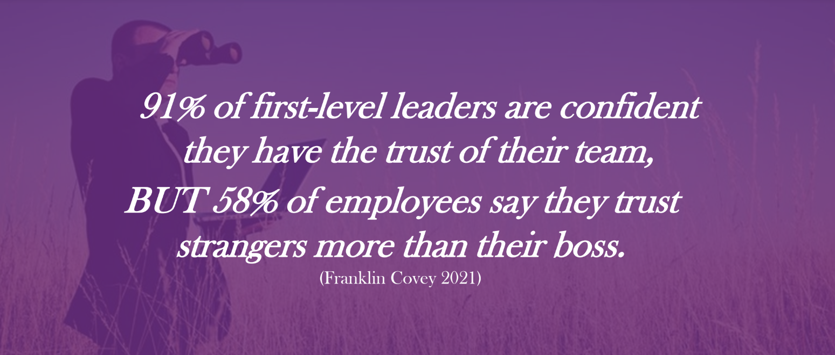

Slide 38
Building trust and connection
Clear obstacles and solve problems
Build relationships
Show you care
Keep your word

Slide 39
Building trust and connection
Transparency
Have their back
Admit when you’re wrong
Explain your decisions

Slide 40
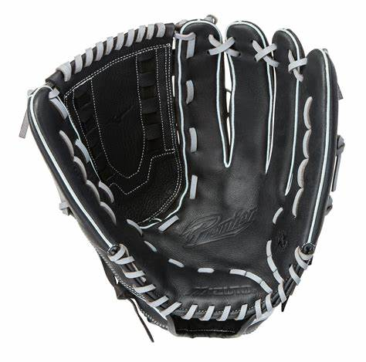

Slide 41
Leaders are culture creators
When people like where they work…
Culture impacts attrition
When they like who they work for…

Slide 42
Why Does Culture Matter?
Morale + productivity + retention
Cost of attrition
Engagement
Reflects the leader

Slide 43
Why Does Culture Matter?
Transcends to products and customers
Impacts referrals and promoter score
Guides connection and teamwork
Shown to impact health

Slide 44
Culture is created by management
Reward performance and results
Follow the 80/20 rule
Weed out low performers
Listen to and implement feedback

Slide 45
Culture is created by management
Create a safe space to disagree
Help people see big picture
Be proactive about burnout
Invest in yourself and the team

Slide 46
Know their appreciation language

Slide 47
What traits do you want in your ideal employee?

Slide 48
Setting expectations
Clarity
Reasonable and logical
Never assume
Provide the resources
Follow up

Slide 49
Remote work success
Productive environment
Remove distractions
Clear expectations

Slide 50
Remote work success
Communicate
Unavailability is okay
Time off
Breaks
Lunches

Slide 51
Managing mixed teams:
Find ways to be inclusive
Consistent expectations
No micromanaging or drifting

Slide 52
When remote work doesn’t work:
Lazy management
Working with the wrong people
Lack of trust or micromanaging

Slide 53
Giving Feedback
Specific
Timely
Fair
Truthful

Slide 54
Giving Feedback
Coach and encourage
Nothing constructive about criticism
Avoidance is contagious

Slide 55
Giving Feedback
Own the feedback
Mindful of emotions
Open to ideas

Slide 56
Reviews
Think: outcome
Neutral site
Reviews create anxiety
Specific appreciation

Slide 57
Reviews
No surprises!
Good – bad – good - plan
Contentious? Ask for help!
Document and follow up

Slide 58
Are you working with the right people?

Slide 59
Delegation is essential
Delegate to empower
No dumping – explain the “why”
Free up your time
No micromanaging
Own it no matter what

Slide 61
Remember the traits of the worst boss you’ve ever had?

Slide 62
What new Managers need

Slide 63
Management mistakes
Lack of growth (Peter Principle)
Insecurity or fear
Trust issues/micromanaging
Being a ‘doer’ instead of manager

Slide 64
More mistakes
Lack of appreciation
Focusing on low performers
Inaccessibility
Balance isn’t valued

Slide 65
More mistakes
Your way is always best
Failing to delegate
Avoidance
Busy-ness disease

Slide 66
Application
Where can your leadership grow?
What’s their appreciation language?
How can you strengthen your influence?

Slide 67
Questions?

Slide 68
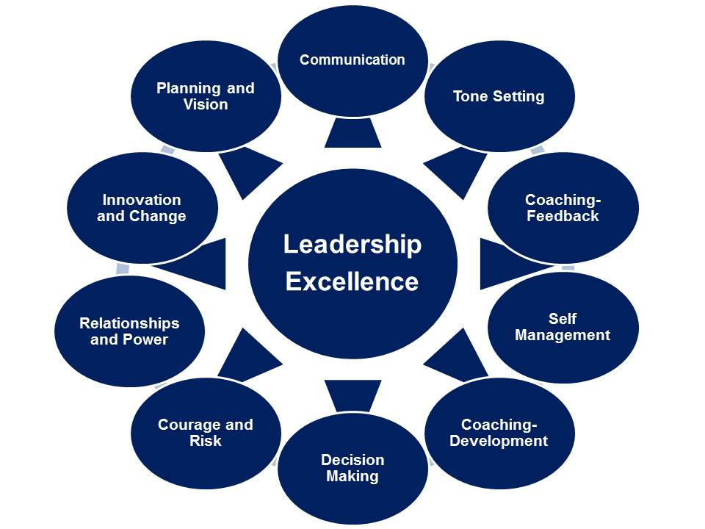
BLI-AICPA LEADERSHIP ACADEMY

