Slide 1
Transforming your budget to deliver outcomes and equity
Notes:
Intro
Thanks to Letitia
How I found my mission - GPRA
Glacier
What I will talk about
Challenges facing local government
Outcome Budgeting, because how a government decides how to spend its money has a lot to do with the value it delivers to people
Also because it is a pathway to advancing equity and sustainability
Some of the ways I’ve seen local governments make amazing improvements to service delivery and resident outcomes. No theory or secondhand smoke today, just stuff I’ve actually implemented myself.
Some thoughts about how to create the conditions for innovation
I hope you’ll feel comfortable chiming in via your microphone or the chat to ask questions, call me crazy, or share your own best practices.
Poll question.

Slide 2
Recession?
Inflation
Vacancies
Pandemic
Notes:
More horsemen?
Not the Apocalypse, but Urban Doom Loop
End of ARPA funds
Equity
Climate change
Affordable housing
Homelessness
Crime
In some ways, these are the best of times for local governments. Many have enjoyed record surpluses and federal funding is coming down like manna from heaven.
But I’m a budgeteer at heart, so I’m always looking around the corner and seeing scary things.
Inflation has eroded the value of all the extra money.
Pandemic continues to be a public health concern, but I include it here mainly because of the ripple effect of remote work on downtowns, and ultimately on local government revenues.
Local government employment still down from pre-COVID levels

Slide 3
The problem
Notes:
What I walked into in when I arrived in Baltimore in early 2008
Story about Mayor’s Objectives
Cart before the horse
In my interview, Mayor Dixon had used two words to describe the budget: black box and autopilot.
I knew I had a mandate to make change.
There had to be a better way

Slide 4
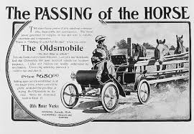
Is there a better way?
Notes:
Is there a better way?
Nod to my hometown of Lansing, MI.
The cart and the horse are gone.
So is Oldsmobile, for that matter, which was born and died in Lansing.
Traditional government budgeting is still alive and well.
What do I mean by traditional budgeting?
- Starts by bringing forward the previous year’s budget
- Organized primarily by fund, department and line-items
- Departments are given funding targets based on previous year, inflation adjustments, revenue forecast
- Shortfalls are solved with across-the-board cuts
- Change from year to year is mostly incremental
How many would say that roughly describes your budget process?
Who would like to change their budget process? Why?
I get the appeal. Incremental budgeting is easy and predictable.
That’s not what need to meet our current challenges, though.
Power Broker passage: give traditional budgeting its due
What I want to talk about is how to budget in a way that puts a premium on performance, drives innovation, and ultimately aligns resources with community goals.
The Price of Government
Budgeting should be about purchasing results, not funding line items.
Also a good platform to budget for equity.

Slide 5
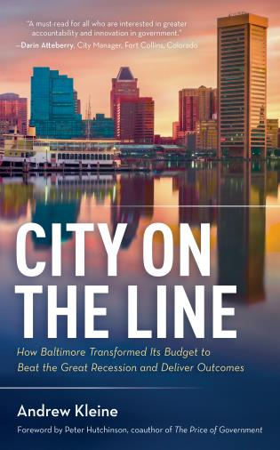
Notes:
I wrote a book about my Baltimore experience and how a bunch of brave public servants bucked status quo budgeting and got better results for residents. I will share a few of their stories with you today.
I brought some copies of my book to give away. One of them will go to the person who asks me the best question at the end.
Book club

Slide 6
Outcome Budgeting’s 3 disruptive innovations
1
Change the starting point for budgeting
2
Put outcomes ahead of the org chart
3
Shift the budget debate
Notes:
Outcome Budgeting is a big change, and change is disruptive, especially when it goes to the heart of what is both the most important and most unyielding process in government.
The way I’ll organize the balance of my talk is around OB’s 3 Disruptive Innovations
OB disrupts traditional budgeting in three ways: it changes the starting point for budgeting, puts outcomes ahead of the org chart, and shifts the budget debate.

Slide 7
Change the starting point
A Safe & Healthy Start
Kindergarten Readiness
Academic Achievement
College & Career Ready
Employment Rate
Number of Jobs
Visitors
Procurement
Prompt Payment
Special Events
Shootings
Property Crime
Perception of Safety
Cleanliness of Waterways
Energy Usage
Recycling Rate
Perception of Cleanliness
Blight Elimination
Neighborhood Investment
Sustainable Transportation
Recreation Visits
Heroin-Related Deaths
Mental Health
Childhood Asthma
Notes:
Starting point
Traditional budgeting: Previous year’s spending plan
OB: Goals for the future
Better Schools, Safer Streets, Stronger Neighborhoods, A Growing Economy, Innovative Government, A Cleaner City, A Healthier City
This is where the action is: defining how you will measure success.
Several other indicators also bring attention to issues that drive disparate outcomes, such as housing affordability and child care.
These indicators are specific enough to build a budget around, but still broad enough to promote creative thinking and collaboration.

Slide 8
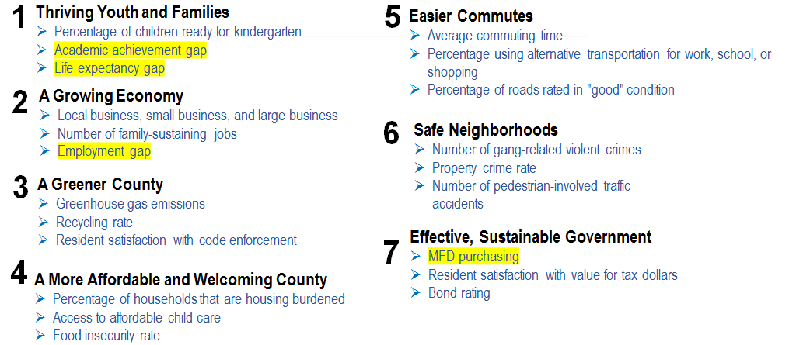
Priority Outcomes and Community Indicators
Notes:
Equity
RFRs

Slide 10
Put outcomes ahead of the org chart

Slide 11
Senior Staff Preference
Actual Budget
Notes:
Outcomes ahead of the org chart
Monopoly Money Exercise
Showed that the base that had built up over time did not reflect the best way to spend taxpayer dollars.
When budgets change only incrementally over many years, they can become disconnected from the results that political leaders want to achieve, the needs of the community, the performance of services being funded, and the effective conversion of dollars into units of service performance, such as trash pickups, street light uptime or high school graduates.
Babak Armajani was my spiritual leader for Outcome Budgeting. Known as “Armi” to his friends and colleagues, he co-founded Public Strategies Group (PSG), the small St. Paul, Minnesota consulting firm that I hired to help me get Outcome Budgeting off the ground in Baltimore. Armi was passionate about making government work better, and he shared his passion with thousands of public servants through his teaching, writing, and coaching. Not long before his untimely death in 2013, he wrote, “I believe that for democracy to realize its full potential, government needs to delight citizens with its services. For the past 30 years, I’ve been trying to figure out how to make WOW! service happen in government.”
Armi wanted Mayor Dixon and her senior team to look at the city’s budget with fresh eyes. He asked them, “If you were starting over, how would you spend the city’s money?” At one of the Mayor’s staff meetings, he placed seven paper bags on the conference table, each labeled with the name of a Priority Outcome. He then gave each team member $100 of Monopoly money and asked them to drop it into the paper bags according to how they think the city should allocate its tax dollars.
As you can see from the pie charts, the way the senior team divvied up the Monopoly money bore no resemblance to how the city was actually allocating the budget. The Monopoly budget reflects the leaders’ instinct that a balanced investment strategy across all the outcomes would get the best results. In the real budget, nearly half the money was going to a single outcome: public safety.
When Armi revealed these pie charts to the team, the reaction was a mix of embarrassment and frustration. Some felt like the Monopoly game was just a cute consulting trick that made them look ignorant about the budget. Those who got the point of the exercise were at a loss for how spending could ever be brought in line with the outcomes they wanted.
Armi’s obituary in the Minneapolis Star-Tribune noted that his family couldn’t remember him losing at Monopoly once in 40 years. He won this time, too, by giving the mayor a clear picture of how she should evolve her budget in the years to come.

Slide 12
Services
Old programs
New services
Regular recreation services
Special recreation services
General park services
Administration
Community recreation centers
Aquatics
Therapeutic recreation
Senior recreation
Youth and adult sports
Special recreation facilities
Urban forestry
Park maintenance
Horticulture
Park programs and events
Administration
Notes:
We’re going deeper into the nuts and bolts of Outcome Budgeting.
The mechanism by which resources are turned into results is services. You may call them programs. We did, too, but decided that services is a more resident-centric term. Services, then, are the units of analysis for budgeting.
To understand how efficiently and effectively tax dollars are being translated into service delivery and outcomes, you first need to understand your services: what they are, what they cost, who runs them, and how they’re measured.
I know some of you have worked with my friend Chris Fabian and Resource X to implement Priority Based Budgeting. Chris tells me that in virtually every engagement he has worked on, breaking down the base budget into bite sized pieces yields surprises and insights. That was certainly true in Baltimore.
Recreation and Parks service transformation -- groundwork
Program structure dated back to the 1960s. When new activities were added, it was easier to put them into an existing program rather than create a new one. Good for the accountants, not so good for a budget analyst – much less a resident – trying to make heads or tails of how the city spent its money.
Explain services, performance measures, data and evidence
Here’s the kicker: In Outcome Budgeting, there’s no such thing as an agency budget proposal. Agencies put together a proposal for each service they want funded, and the services are grouped by Priority Outcome for review. In the Rec and Parks example, some of their services supported Thriving Youth and Families, some supported A Greener City, some supported A Healthier City.

Slide 13
Shift the budget debate
Priority
High performance ranking
Low alignment with Priority Outcomes
Low on Resident Ranking
High performance ranking
High alignment with Priority Outcomes
High on Resident Ranking
Performance
Low performance ranking
Low alignment with Priority Outcomes
Low on Resident Ranking
Low performance ranking
High alignment with Priority Outcomes
High on Resident Ranking
Notes:
Shift the budget debate
Results Teams are the keepers of the Value Flame
Write RFRs, review and rank proposals, recommend “investment portfolio” to leadership.

Slide 14
Priority-performance matrix
Priority
Could be overkill
Keep up the good work
Community action centers
Towing
Sustainable transit
Real property management
Street management
Performance
Liquor board
Comp planning
Keep a low profile
Aquatics
Housing combined
Boarding and rat baiting
Rec Centers
Meet the challenge
Disabilities commission
Stronger neighborhoods
Notes:
Results Teams are the heart of OB
Where the magic happens
Mayors love this, they can see at a glance where thy need to focus attention and where they can make budget tradeoffs
Dixon’s black box
Discussion was more about performance than dollars.
Why was a service underperforming? Management, design, external factors, partnerships, funding.
Bring services out from under the radar screen

Slide 15
Drilling platform
Key purchases
Higher priorities
What’s not purchased
Lower priorities
Notes:
Drilling Platform slide – Price of Government
Jackie Duval-Harvey
Recreation Centers story

Slide 16
Notes:
Where the magic happens – Jim Chrisinger story
Brought budget decisions out of the back room
Employees and community members
Beth Strommen and Inez Robb story
Shifting the line between government and the community
Graffiti slide

Slide 17
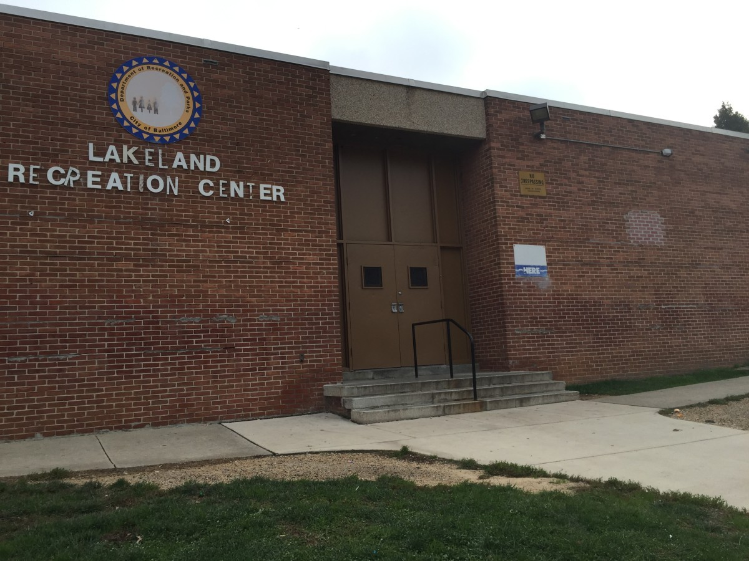
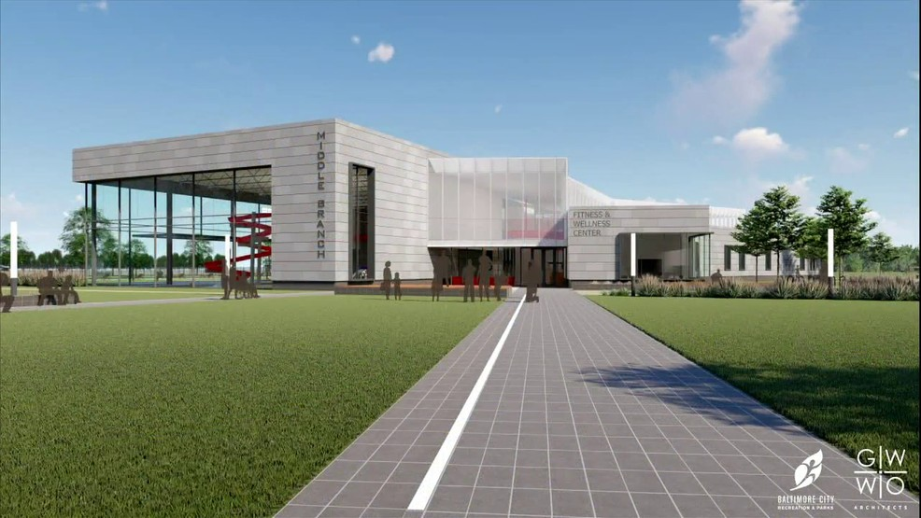
Less is more
Notes:
Non-profits and schools

Slide 18
Bottom line is value
Improve value by …
Getting more results for the same dollars
Getting the same results for fewer dollars
Or, best …
Getting more results for fewer dollars Innovation!
Notes:
OB is only as good as the ideas people have to add value.
Innovation is sometimes an accident, but not usually. We wanted to give people the permission, tools and incentive to innovate.
We started an Innovation Fund.
- Camp Small (share link)
We opened an Innovation Lab.
Book Club
Lean

Slide 19
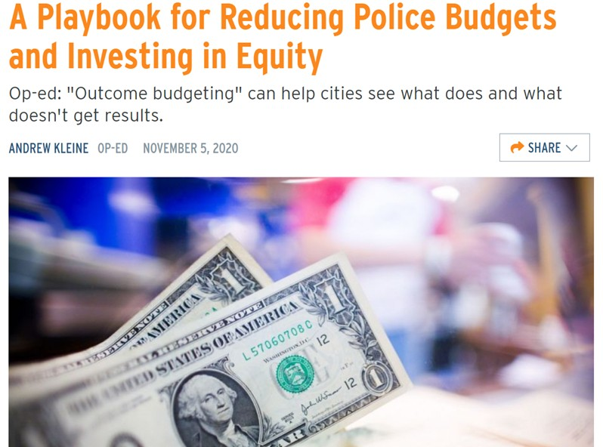
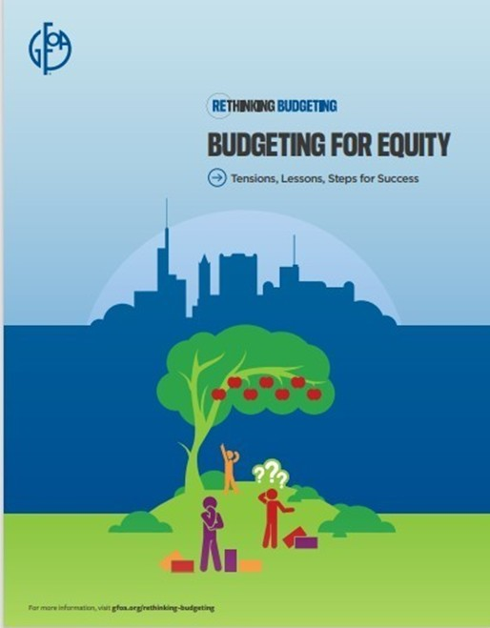
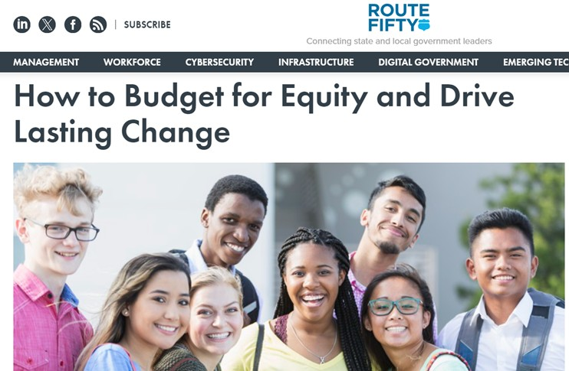
Budgeting for equity

Slide 20
How are you reflecting equity in your budget?
We have defined equity and fully integrated equity into how we make budget decisions
B. We have made progress in considering equity in our budget decisions
C. We talk a good game, but our budget process hasn’t really changed
D. Did you say equity?

Slide 21
Notes:
“Stay in your lane.”
That’s what I was told by then Baltimore Mayor Stephanie Rawlings-Blake’s chief of staff after nearly an hour arguing with the police commissioner about cutting his department’s spending in order to fund longer-term crime reduction strategies like youth development, job training and drug treatment.
This admonishment happened in Baltimore’s City Hall, but it could have happened in any city or town in America. For too long, police departments have been off-limits to the scrutiny of budget analysts and exempted from cuts, even in tough times, which can lead to bloat, arrogance and laziness in their spending habits.
A sea change in the culture of police budgeting – and local government budgeting generally – is long overdue.
A results team made up of city employees and residents examined dozens of budget proposals for making Baltimore safer. It found that much of police spending didn’t make sense, as the services provided either were duplicative or had little return on investment. And despite having a large number of police officers, historical data and research indicated that crime reduction is less about the number of officers on the streets and more about how they are deployed.
Simply put, the results of several police activities weren’t worth the dollars spent. Recognizing that, the team proposed a long list of adjustments to the police budget: curb overtime spending; collect more crime reports via phone; disband the largely ceremonial mounted unit; ground one of four helicopters, which assist on only a small fraction of arrests; staff the marine unit seasonally; civilianize administrative positions; and abolish long-vacant positions.

Slide 22
Black Homeownership Indicator

Slide 23
The Story Behind the Curve
Positive Factors
TIF set-aside
Economic recovery & stimulus
New affordable developments
Low interest rates
Madison Area Land Trust
Downpayment assistance
Home buyer education
Negative Factors
Restrictive zoning & building codes
“Missing middle” in housing market
Bias & discrimination
Gentrification
Limited savings & access to credit
Limited career pathways
Lack of financial mentorship
High cost of homeownership

Slide 24
The team generated 31 What Works actions …
Actions distilled from informed brainstorming
Actions directly address the factors identified
They cover a wide range: low cost/no cost, evidence-based or promising, and “off-the-wall”

Slide 25
… and scored them using 4 criteria
Equity (40%)
Impact (25%)
Actionable (20%)
Feasibility
(15%)

Slide 26
Priority Strategies
Strategy 1: Improve economic opportunity and career pathways for BIPOC
Strategy 2: Grow the supply of affordable housing
Strategy 5: Increase financial education and access to credit for BIPOC
Strategy 3: Help low- and moderate-income residents maintain homeownership
Strategy 4: Combat bias and discrimination in the real estate system

Slide 27
Strategy 4: Combat bias and discrimination in the real estate system
Compare property assessment and sales data to identify and address disparities
Strengthen enforcement of fair housing laws
Offer free legal services to first-time homebuyers

Slide 28
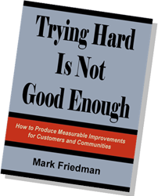
Notes:
How do we connect our Priority Outcomes and Community Indicators to the budget?
It took some trial and error in Baltimore, but we eventually discovered Turn the Curve planning.
“Turn the Curve” planning is based on the principles of Results-Based Accountability as explained in Mark Friedman’s book Trying Hard Is Not Good Enough.

Slide 29
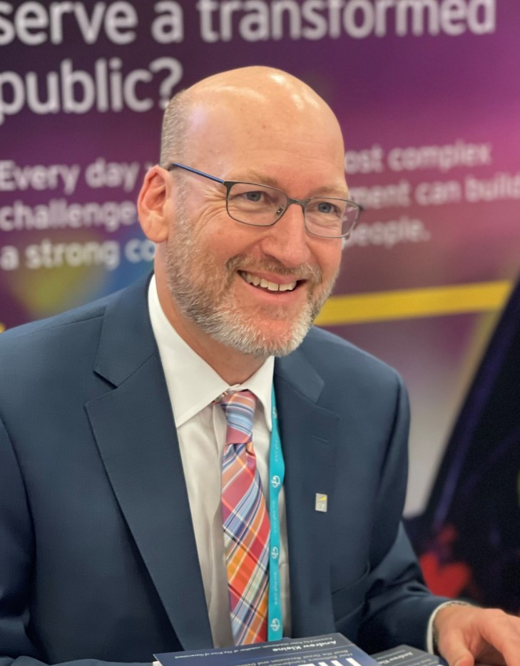
Keep in touch …
andrew.kleine@ey.com
@awkleine
www.cityontheline.com
Questions from the Edge
Things Only Budgeteers Understand
Notes:
Bonus content!
AI Budget Explorers

Slide 30
EY | Building a better working world
EY exists to build a better working world, helping create long-term value for clients, people and society and build trust in the capital markets.
Enabled by data and technology, diverse EY teams in over 150 countries provide trust through assurance and help clients grow, transform and operate.
Working across assurance, consulting, law, strategy, tax and transactions, EY teams ask better questions to find new answers for the complex issues facing our world today..
EY refers to the global organization, and may refer to one or more, of the member firms of Ernst & Young Global Limited, each of which is a separate legal entity. Ernst & Young Global Limited, a UK company limited by guarantee, does not provide services to clients. Information about how EY collects and uses personal data and a description of the rights individuals have under data protection legislation are available via ey.com/privacy. EY member firms do not practice law where prohibited by local laws. For more information about our organization, please visit ey.com.
Ernst & Young LLP is a client-serving member firm of Ernst & Young Global Limited operating in the US.
About EY-Parthenon
EY-Parthenon teams work with clients to navigate complexity by helping them to reimagine their eco-systems, reshape their portfolios and reinvent themselves for a better future. With global connectivity and scale, EY-Parthenon teams focus on Strategy Realized — helping CEOs design and deliver strategies to better manage challenges while maximizing opportunities as they look to transform their businesses. From idea to implementation, EY-Parthenon teams help organizations to build a better working world by fostering long-term value. EY-Parthenon is a brand under which a number of EY member firms across the globe provide strategy consulting services. For more information, please visit ey.com/parthenon.
© 2021 EYGM Limited. All Rights Reserved.
2101-3682551
ED None
This material has been prepared for general informational purposes only and is not intended to be relied upon as accounting, tax, legal or other professional advice. Please refer to your advisors for specific advice.
ey.com

Slide 31
Innovation Fund

Slide 32
Lean
Notes:
Trained 1,000 employees

Slide 33
Notes:
Gainsharing
Wanted employees to share in the savings from their great ideas.
Poll 2

