Slide 1
Family and Medical Leave Insurance Program - Time to Care Act of 2022
April 26, 2024

Slide 2
Overview
State of Maryland Senate Bill 275
Establishes the Family and Medical Leave Insurance (FAMLI) Program and Fund
Program provides benefits to employees in Maryland who take leaves of absence from work for family or medical reasons
All employers will be required to provide paid family and medical leave insurance, which can be provided through the State Plan, a commercial plan, or a self-insured option.

Slide 3
Program Administration
Establish procedures and forms for filing claims for benefits;
Carry out a public education program;
Every two years conduct a cost analysis of the program that is focused on the cost of maintaining solvency and paying benefits to covered individuals;
Establish standards in regulations for certifying benefit claims;
Establish procedures for an employer to provide evidence of suspected fraud;
System for appeals by individuals who are denied benefits;
Ensure information is confidential.

Slide 4
Eligibility
Public and private employees who worked 680 hours or more during the 12-month period preceding the leave of absence date will be eligible for benefits
Self-employed workers can opt into the program

Slide 5
Qualifying Events
To welcome a child into their home, including through adoption and foster care
To care for themselves, if they have a serious health condition
To care for a family member’s serious health condition
Care for next of kin military service member with a serious health condition resulting from military service
To make arrangements for a family member’s military deployment

Slide 6
FAMLI Benefits
90% of wages up to 65% of Maryland’s Average Weekly Wage (AWW) plus 50% of salary over 65% of AWW
General Assembly is considering AWW used for unemployment insurance purposes ($1,402 in 2023)
Minimum weekly benefit amount is $50; Maximum is $1,000 for first year (subsequently adjusted by CPI)
Benefit period is generally 12 weeks of leave in a 12-month period

Slide 7
Contribution Rates to the Fund
0.90% of covered wages (all wages up to and including the Social Security wage base).
Rate equally divided between employees and employers.
Employers with 14 or fewer employees contribute 0.45% (employee can pay full amount)
Employers may choose to cover part or all of their workers’ contributions.

Slide 8
Prohibited Acts and Penalties
An individual is disqualified from receiving benefits for one year if the individual willfully makes a false statement or misrepresentation regarding a material fact or willfully fails to report a material fact to obtain benefits.
MDL can seek repayment of benefits from the individual.
An employer is subject to a civil penalty of up to $1,000 for each occurrence if the employer willfully makes or causes to be made a false statement or willfully fails to report a material fact regarding an employee’s claim for benefits.
If an employer fails to pay contributions due to the fund, the Secretary may assess the amount of contributions and interest due, make an additional assessment of up to two times the contributions withheld as a penalty, and order an audit of the employer for the immediately following fiscal year to investigate and determine compliance with the bill and other labor laws.

Slide 9
Other Considerations
Eligibility and contributions are dependent on working in Maryland.
Quarterly wage and hour reporting is required to the Division.
An online portal system for workers and employers is currently under development.
Employers that already provide equal to or better benefits than the State Plan can seek approval for a self-insured plan.

Slide 10
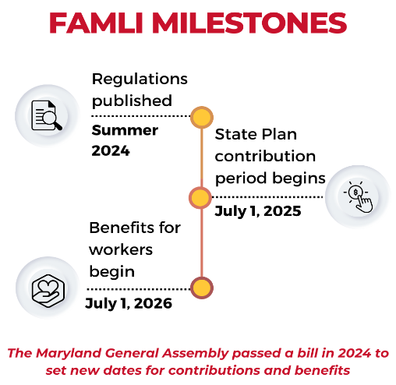
Current Timeline

Slide 11
Study of Maryland Family and Medical Leave Insurance Program
Prepared by Spring Consulting Group for Maryland Department of Legislative Services
Study capability and capacity of the MDL to implement and administer the FAMLI program
Estimated population (2025) of 2,537,000 individuals and 205,000 claims
Estimated annual administration cost of $65 million in first full year (insourced model)
Estimated staff count of 466

Slide 12
Actuarial Information Used in Cost Analysis
Actuarial Study conducted by Milliman and commissioned by UB in 2022
Cost sharing method (50/50 split) for first full year
Eligible employees – 2.6 million
Claims – 187,455
Total taxable wages - $183.4 billion
Contributions to the State Plan – $1.7 billion
Benefit payments - $1.4 billion

Slide 13
Options
State Plan
Self-administered Plan
Alternative Plan
Maryland Municipal League, MACo and MABE co- operative

Slide 14
How to Prepare Now
Keep an eye out for information about how to register for an account on the online portal. After registration, all employers will automatically be enrolled in the State Plan. You can alternatively explore private plans.
Sign up to receive emails from the FAMLI team.
Invite the FAMLI team to share information at an upcoming meeting or event
Include contributions in future budget planning and consider whether to cover a portion or all of your employees’ contribution.
Begin including FAMLI contributions in future budget planning.
Start thinking about how your existing benefits may interact with FAMLI.
Begin discussing any payroll/administrative adjustments you may need to make
Evaluate whether you may need policy and handbook changes.
Begin talking with your employees, so they understand their future FAMLI benefits and contributions.

Slide 15
Resources
State Resource - https://paidleave.maryland.gov/Pages/default.aspx
Draft Regulations - https://paidleave.maryland.gov/stakeholders/Documents/FAMLI%20Regs%20Draft.pdf
Milliman/UB Study - https://dlslibrary.state.md.us/publications/Exec/MDL/SB275,2022Ch48(11)(2022)_2022(d)(att).pdf
Spring Consulting Group/DLS Study –
https://dls.maryland.gov/pubs/prod/NoPblTabPDF/MarylandDLS_StudyofFAMLIProgram.pdf

Slide 16
Contact Information
Christopher Lehman, CPA
Audit Partner
Office: 410-584-2201
Cell: 301-785-7408
clehman@sbandcompany.com
Executive Assistant: Danae Henry
Office: 410-584-0060
dhenry@sbandcompany.com

